Slide 1



Airport Authority Data Analysis
View in Power BI
Last data refresh:
28.05.2023 22:27:17 UTC
Downloaded at:
02.06.2023 11:24:17 UTC

Slide 2
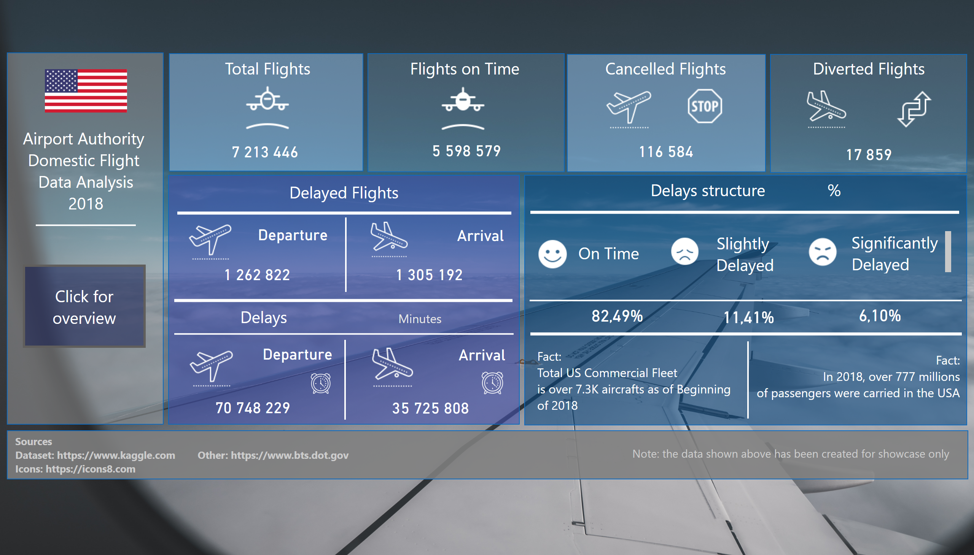
Main Page
Notes:
shape
No alt text provided
Arrival
No alt text provided
Departure
No alt text provided
image
No alt text provided
image
No alt text provided
shape
No alt text provided
textbox
No alt text provided
textbox
No alt text provided
Departure
No alt text provided
shape
No alt text provided
image
No alt text provided
image
No alt text provided
Arrival
No alt text provided
image
No alt text provided
shape
No alt text provided
Flights on Time
No alt text provided
image
No alt text provided
image
No alt text provided
shape
No alt text provided
Total Flights
No alt text provided
image
No alt text provided
shape
No alt text provided
shape
No alt text provided
textbox
No alt text provided
image
No alt text provided
textbox
No alt text provided
image
No alt text provided
image
No alt text provided
image
No alt text provided
card
No alt text provided
card
No alt text provided
card
No alt text provided
shape
No alt text provided
textbox
No alt text provided
textbox
No alt text provided
textbox
No alt text provided
textbox
No alt text provided
shape
No alt text provided
actionButton
No alt text provided
shape
No alt text provided
textbox
No alt text provided
textbox
No alt text provided
textbox
No alt text provided
shape
No alt text provided
shape
No alt text provided
shape
No alt text provided
shape
No alt text provided
shape
No alt text provided
shape
No alt text provided
shape
No alt text provided
shape
No alt text provided
card
No alt text provided
card
No alt text provided
textbox
No alt text provided
textbox
No alt text provided
textbox
No alt text provided
textbox
No alt text provided
image
No alt text provided
image
No alt text provided
image
No alt text provided
image
No alt text provided
actionButton
No alt text provided
actionButton
No alt text provided
actionButton
No alt text provided
shape
No alt text provided
shape
No alt text provided
actionButton
No alt text provided

Slide 3
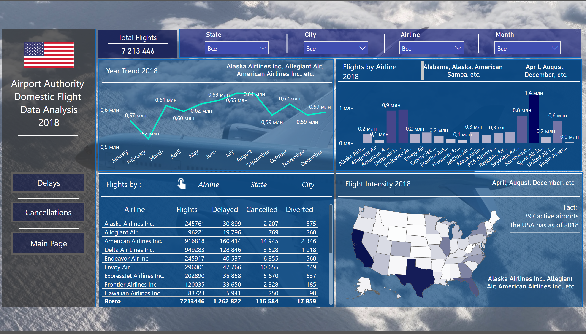
Flight Analisys
Notes:
shape
No alt text provided
textbox
No alt text provided
image
No alt text provided
actionButton
No alt text provided
actionButton
No alt text provided
shape
No alt text provided
shape
No alt text provided
Flights by Month
No alt text provided
textbox
No alt text provided
shape
No alt text provided
shapeMap
No alt text provided
textbox
No alt text provided
card
No alt text provided
shape
No alt text provided
Total Flights by Airline
No alt text provided
textbox
No alt text provided
card
No alt text provided
shape
No alt text provided
tableEx
No alt text provided
Airlines
No alt text provided
textbox
No alt text provided
Button State
No alt text provided
Button City
No alt text provided
Button Airline
No alt text provided
tableEx
No alt text provided
shape
No alt text provided
card
No alt text provided
card
No alt text provided
shape
No alt text provided
shape
No alt text provided
shape
No alt text provided
textbox
No alt text provided
shape
No alt text provided
shape
No alt text provided
Slicer Month
No alt text provided
Slicer Airline
No alt text provided
Slicer Airline
No alt text provided
shape
No alt text provided
Slicer Airline
No alt text provided
shape
No alt text provided
card
No alt text provided
textbox
No alt text provided
shape
No alt text provided
shape
No alt text provided
shape
No alt text provided
shape
No alt text provided
actionButton
No alt text provided
shape
No alt text provided
card
No alt text provided
shape
No alt text provided
shape
No alt text provided
image
No alt text provided

Slide 4
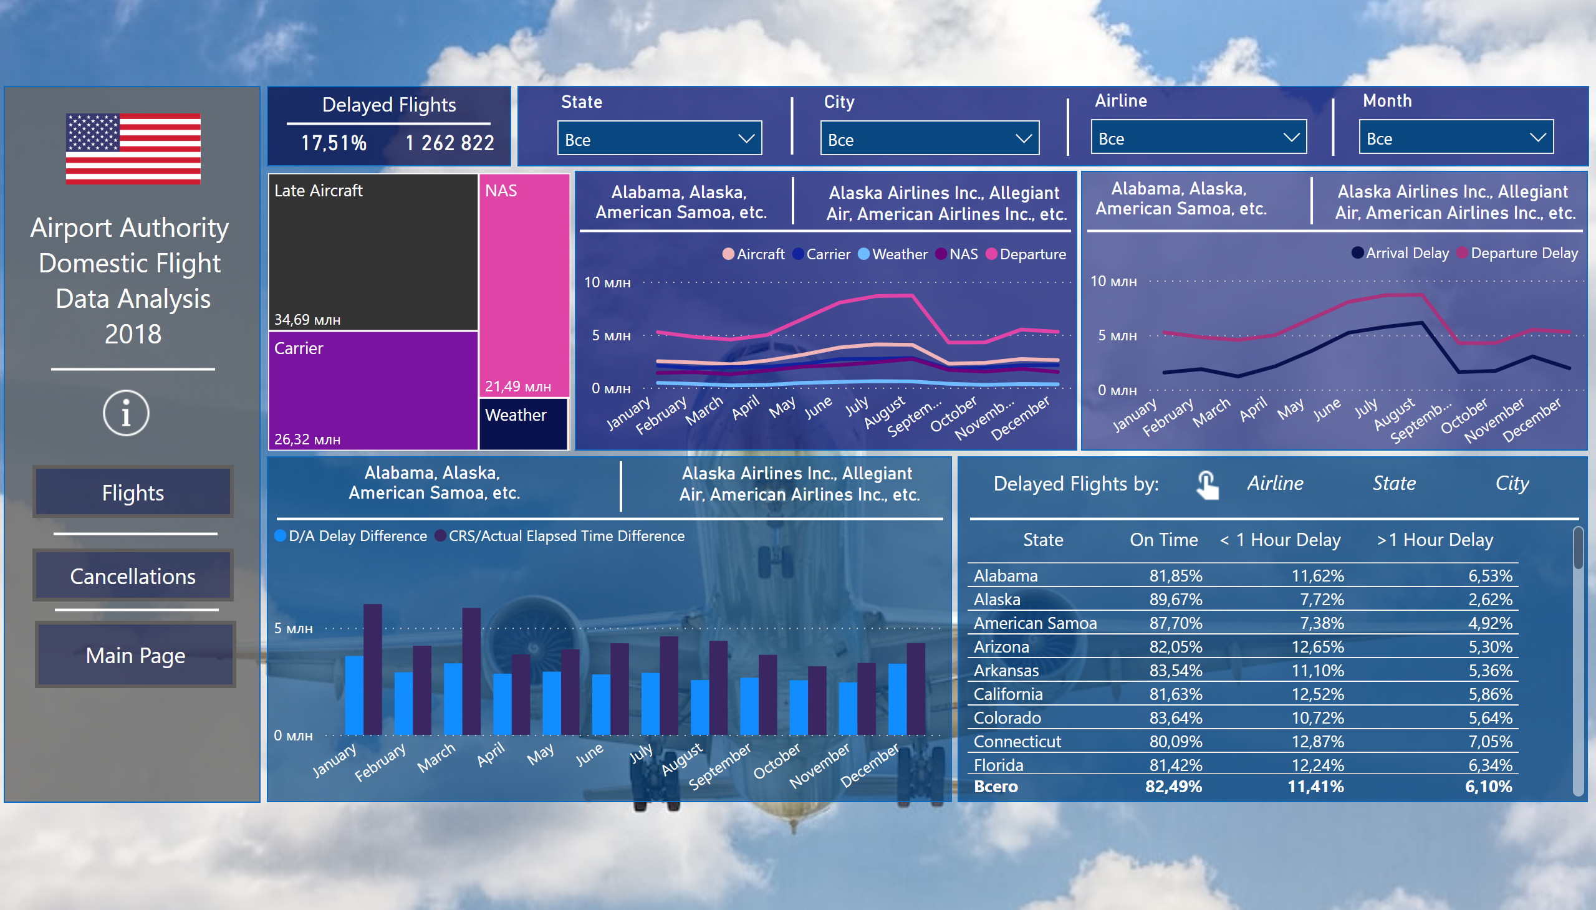
Delay Analysis
Notes:
Delay Reasons
No alt text provided
shape
No alt text provided
textbox
No alt text provided
image
No alt text provided
actionButton
No alt text provided
actionButton
No alt text provided
shape
No alt text provided
actionButton
No alt text provided
shape
No alt text provided
shape
No alt text provided
shape
No alt text provided
slicer
No alt text provided
slicer
No alt text provided
slicer
No alt text provided
shape
No alt text provided
shape
No alt text provided
slicer
No alt text provided
shape
No alt text provided
shape
No alt text provided
Departure
No alt text provided
textbox
No alt text provided
shape
No alt text provided
shape
No alt text provided
clusteredColumnChart
CRS - strong tool in delays management
shape
No alt text provided
tableEx
No alt text provided
Button Airline
No alt text provided
Button State
No alt text provided
Button City
No alt text provided
shape
No alt text provided
shape
No alt text provided
textbox
No alt text provided
Departure
No alt text provided
Departure
No alt text provided
shape
No alt text provided
shape
No alt text provided
lineChart
No alt text provided
shape
No alt text provided
Types of Delay Contribution in Minutes by Month
No alt text provided
shape
No alt text provided
shape
No alt text provided
Departure
No alt text provided
Departure
No alt text provided
Departure
No alt text provided
Departure
No alt text provided
shape
No alt text provided
shape
No alt text provided
Departure
No alt text provided
image
No alt text provided
Table State
No alt text provided
tableEx
No alt text provided
image
No alt text provided
image
No alt text provided

Slide 5
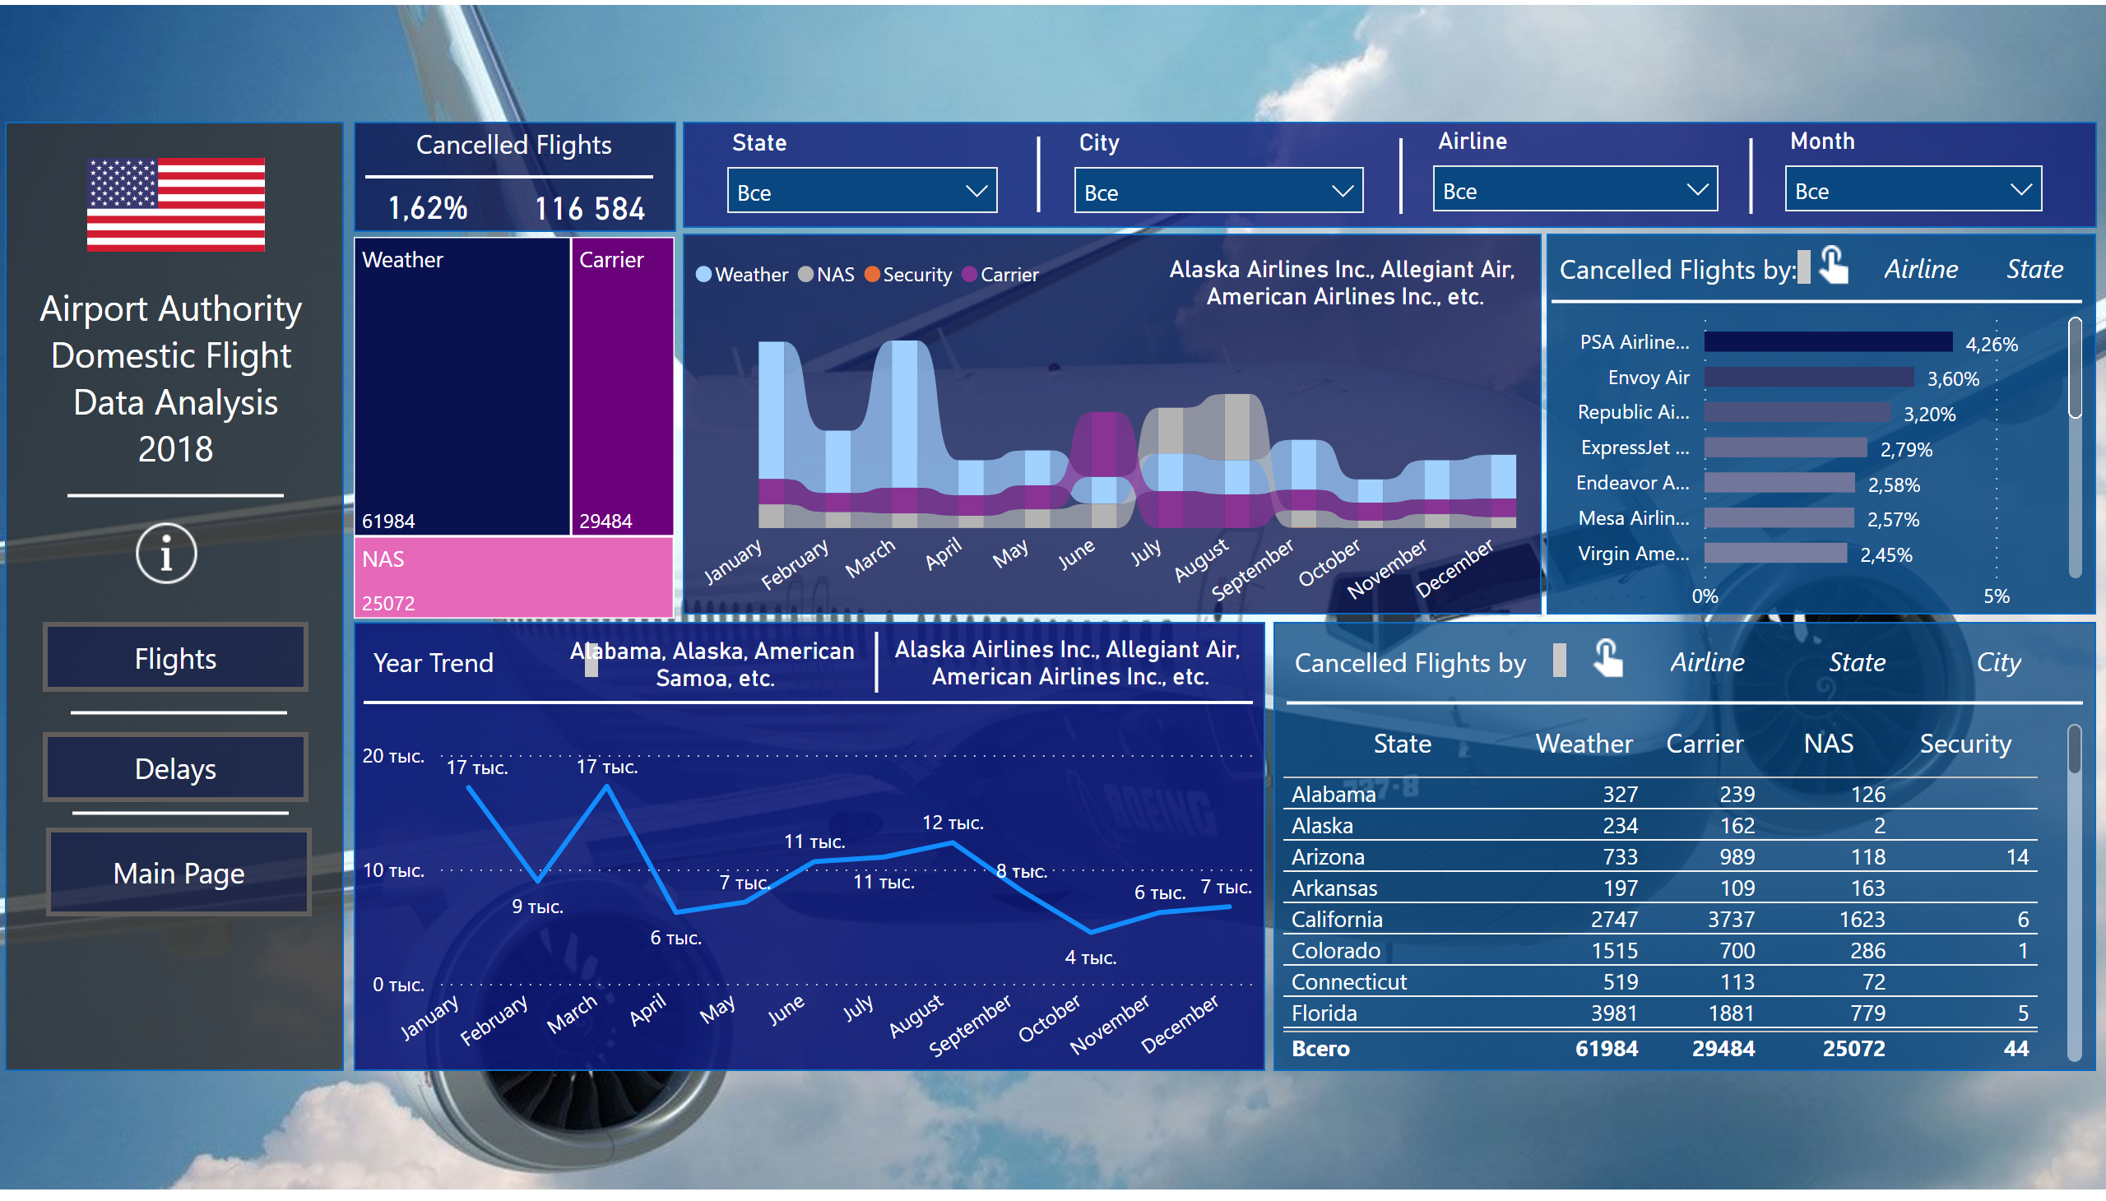
Cancellation Analysis
Notes:
Reasons of Cancellation
No alt text provided
shape
No alt text provided
lineChart
No alt text provided
shape
No alt text provided
textbox
No alt text provided
image
No alt text provided
actionButton
No alt text provided
actionButton
No alt text provided
shape
No alt text provided
actionButton
No alt text provided
shape
No alt text provided
shape
No alt text provided
shape
No alt text provided
card
No alt text provided
shape
No alt text provided
slicer
No alt text provided
slicer
No alt text provided
slicer
No alt text provided
card
No alt text provided
textbox
No alt text provided
shape
No alt text provided
shape
No alt text provided
barChart
No alt text provided
textbox
No alt text provided
Airline
No alt text provided
Button State 1
No alt text provided
shape
No alt text provided
tableEx
No alt text provided
textbox
No alt text provided
textbox
No alt text provided
shape
No alt text provided
shape
No alt text provided
barChart
No alt text provided
card
No alt text provided
shape
No alt text provided
shape
No alt text provided
slicer
No alt text provided
shape
No alt text provided
shape
No alt text provided
ribbonChart
No alt text provided
card
No alt text provided
State Table
No alt text provided
tableEx
No alt text provided
Button State
No alt text provided
Button City
No alt text provided
Button Airline 1
No alt text provided
card
No alt text provided
shape
No alt text provided
shape
No alt text provided
image
No alt text provided
image
No alt text provided
image
No alt text provided
image
No alt text provided

